Slide 1
1) Introduction 2) Analytics Fundamentals
Review of data and statistical basics, and software fundamentals

Slide 2
Review of Statistical Tests
Hypothesis tests consist of three basic components
1) Hypothesis Statements: null (Ho) and alternative (H1)
2) Decision Rule: based on sample evidence (test statistic or p-value), what to conclude (Ho or H1)
3) The Decision
P-values provide a very general way to conduct tests, and also measure the extent that the sample evidence is consistent with Ho.
For any test, the decision rule is as follows:
If P-Value < Alpha, conclude H1
Otherwise , conclude Ho.

Slide 3
Review of Chi-Square tests for categorical data (or numeric data that has been categorized)
Chi-Square tests are versatile procedures useful for testing whether data conform to a theoretical distribution, and whether variables are independent.
The basic procedure is as follows: (1) Formulate the hypotheses (Ho,H1) , (2) Determine the data frequencies that you would expect if Ho (null) true, (3) Compare expected data freqs. with actual data freqs in your sample (using the Chi-square statistic). (4) Come to a conclusion using the Chi-square distribution.

Slide 4
Beer Preference f_{o} (f_{e})
Light Reg. Dark Total
Male 20(26.67) 40(37.33) 20(16.00) 80
Female 30(23.33) 30(32.67) 10(14.00) 70
Total 50 70 30 150
Test statistic = X² = S(f_{o} – f_{e})²/f_{e} = (20-26.67)²/26.67 + …+ (10-14.00)²/14.00
=6.13
Decision Rule: Conclude H1 if p-value < alpha=.05, else Ho.
P-value = P(X² > 6.13) = .0467. So, conclude H1 since .0467 < .05.

Slide 5
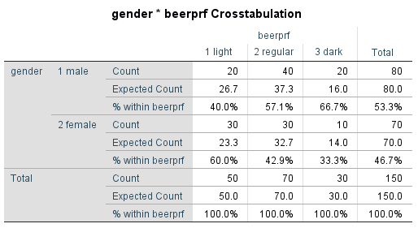

Slide 6
3) Regression Review and Extensions

Slide 7
Regression Analysis
Conceptual Model for simple linear regression
Y = β_{o} + β₁X + ε
Where the errors are assumed independent, normal, with mean 0 and constant variance
Note that
β₁ is a point estimator of β₁
β_{o} is a point estimator of β_{o}
Y is a point estimator of β_{o} + β₁X = μ
(and also a point estimator of a predicted Y value)
^
^
^

Slide 8
Regression Analysis
Software output for our simple linear regression example
Analysis of Variance (ANOVA)
Sum of
Squares
Regression 76.20608
Residual 9.00452
Total 85.21060
R-Square 0.8943
Probability value (p-value) to test if AdExp should be dropped from model (if sample evidence indicates corresponding Beta =0 or not). Typical rule, if p-value < .05, conclude corresponding Beta is not 0)
Confidence limits provide information about the precision of the estimate

Slide 9
Regression Analysis
Multiple Regression
Multiple regression conceptual model
Y = β_{o} + β₁X₁ + β₂X₂ + … + β_{k}X_{k} + ε
Extending our example by including a second explanatory variable: point-of-sale expenditure (X₂₎

Slide 11
Estimating the Mean Y Value and Predicting an Individual Y Value (Forecasting)
For our grocery store sales example, what would you estimate average sales to be if $4,500 is spent on Advertising and $5,500 on POS?
Recall our estimated regression equation
Sales = 5.245 + 1.952 AdExp + 0.527 POSExp
What would you predict sales to be next period at a location that spends $4,500 on advertising and $5,500 on POS?
^

Slide 12
Estimating the Mean Y Value and Predicting an Individual Y Value (Forecasting)
^
Y provides point estimates of both the mean value of Y and a predicted individual Y value.
As a point estimate, we don’t obtain information about precision. Confidence intervals/limits provide information about precision.
Statistical software packages (e.g., SPSS) will provide these interval estimates if requested.
For our grocery sales example, the 95% interval estimate for mean sales with AdExp=$4,500 POSExp= $5,500 is
(16.55, 17.30) Y +/- t*SE(mean)
The 95% prediction interval with AdExp=$4,500 POSExp= $5,500 is
(15.75, 18.10) Y +/- t*SE(predicted)
Interpretation? Is it reasonable that the prediction interval is wider?
^
^

Slide 13
Qualitative Predictor Variables
Example
A researcher is interested in the effects of years of industry experience and gender on sales performance for a particular population of sales force professionals.
The qualitative characteristic (gender) will be incorporated in the model using a 0,1 indicator (dummy) variable defined as follows:
X₂ = 1 if female, 0 otherwise (male)
Note that with two categories we only need one indicator variable.
The category coded as 0 is called the reference or base category.
In general, a qualitative variable with c classes will be represented by c – 1 indicator variables.
Our resulting model is as follows:
Y_{i} = β_{o} + β₁X₁ + β₂X₂ + ε
Where X₁ = years of industry experience
X₂ ₌ 1 if female, 0 otherwise (male)

Slide 14
Interpretation of Coefficients
The associated regression function is
β_{o} + β₁X₁ + β₂X₂
For men, X₂ = 0 β_{o} + β₁X₁
For women, X₂ = 1 β_{o} + β₁X₁ + β₂
(β_{o} + β₂) + β₁X₁
Sales
Yrs. Exp. (X1)

Slide 15
Model Containing Interaction Effects
Extending our model, suppose there could be differences both in the intercepts and slopes between sales performance for men as compared to women.
The associated model is: Y_{i} = β_{o} + β₁X₁ + β₂X₂ + β₃ X₁X₂ + ε
Where X₁ = years of industry experience
X₂ ₌ 1 if female, 0 otherwise (male)
X₁X₂ = interaction variable
Interpretation of Coefficients
For men, X₂ = 0 β_{o} + β₁X₁
For women, X₂ = 1
β_{o} + β₁X₁ + β₂ + β₃ X₁
(β_{o} + β₂) + (β₁ + β₃)X₁

Slide 16
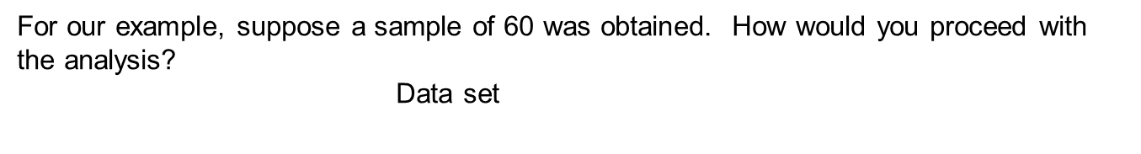
M
Sales
Yrs. Experience (X1)
Data in file Sales.force.Sales.sav
Obs | YrsExp | Gender | YG | Sales ($0000)
1 | 27 | 0 | 0 | 158.83
2 | 29 | 0 | 0 | 161.22
3 | 25 | 0 | 0 | 161.88
. | . | . | . | .
. | . | . | . | .
. | . | . | . | .
58 | 17 | 1 | 17 | 151.16
59 | 12 | 1 | 12 | 113.73
60 | 21 | 1 | 21 | 157.36

Slide 17
Added Application.
2) A consultant studied the relation between selling price and assessed valuation of one-family dwellings in a district for a sample of 64 recent sales. In addition, the dwellings were identified as to whether the dwelling was located on a corner lot.
File Corner_lot.sav has the data with the following variables: Selling price (the dependent variable) in $000 (SP), assessed valuation in $000 (AV), and lot location indicator (CL) (1= corner lot, 0 = non – corner lot). Estimate an appropriate model and interpret your results.

Slide 18
Multicollinearity
If the predictors are uncorrelated amongst themselves, or not highly correlated, then our usual inferences and interpretations are not affected/problematic. However, if the predictors are highly correlated amongst themselves, a condition called multicollinearity exists which causes problems with regard to inferences and interpretations regarding coefficients.

Slide 20
Compare

Slide 21
Variable Selection Methods
Forward Selection: Starting with no predictors in the model, predictors are entered one at a time if their corresponding P-values are less than some prespecified level.
Backward Elimination: Starting with all predictors in the model, predictors are removed one at a time if their corresponding P-values are larger than some prespecified level.
Stepwise: Forward selection is combined with backward elimination in a step by step fashion.
Different variable selection procedures can result with different sets of “final” variables.
In general, when comparing the results of two models, the value of R square is not a good measure for comparison. R square can never decrease when predictors are added.
Instead, Adjusted R square should be used to make comparisons. Adjusted R square adjusts for the number of predictors.
R square = 1 - SSE/SST
Adj. R square = 1 - [ SSE/(n-k-1)/SST/(n-1)]

Slide 22
Added Application 3)
SPSS file “CRE_data_est_smp.sav” is a commercial real estate data set (600 records) with information on age in years, operating expenses and taxes in $ per sq.ft., vacancy rate, total square footage, and rental rate in $ per sq.ft.
Perform a regression analysis to obtain a forecasting model for rental rate.
Excel file CRE_data_val_smp.xlsx contains data for 400 additional properties. Use this data set to evaluate the model you obtained in a). Provide a Word document of your output and explanation of your evaluation.

Slide 23
4) Conjoint and Discrete Choice

Slide 24
Overview: Conjoint and Discrete Choice
In Conjoint/Discrete Choice products/services are usually presented as a bundle of features and prices in such manner that the respondent must :
Rank or rate (Conjoint)
Conjoint types include
full profile
self explicated
Choose one or several (Discrete Choice).

Slide 25
Self-Explicated “Conjoint” and Conjoint Fundamentals
For our bread maker example
Brand Loaf Shape Price
Oster Square $139
Braun Rectangular $149
Sears $159
Panasonic
Recall the basic conjoint utility function
Total utility of a product/service = sum of constituent component utilities (part-worths)
U = βOster + βBraun + βSears + βPanasonic +
βShape₁ + βShape₂ +
βPrice₁ + βPrice₂ + βPrice₃
Utility of Oster, Rectangular shape, at $139 = βOster + βShape₂ + βPrice₁

Slide 26
Reporting Conjoint Results: Descriptives and Conjoint Simulators
Average Utilities and importance scores are common top line summaries, and are also commonly used in displays. However, need to be careful with interpretations. Below is a chart constructed using mean results from 5 respondents.

Slide 27
Reporting Conjoint Results: Conjoint Market Simulation and Simulators
Conjoint utilities are typically used to simulate preference share in the marketplace. Market simulators automate the simulation task and readily allow users to model preferences and estimate shares. Simulators are commonly used to conduct what-if types of analyses and address marketing issues that include: product optimizations, new product introductions, pricing analyses.
Simulating Choice
Assuming rational consumers and a maximum utility structure, product/service preferences can be predicted based upon comparisons of individual level product/service utility composition.

Slide 28
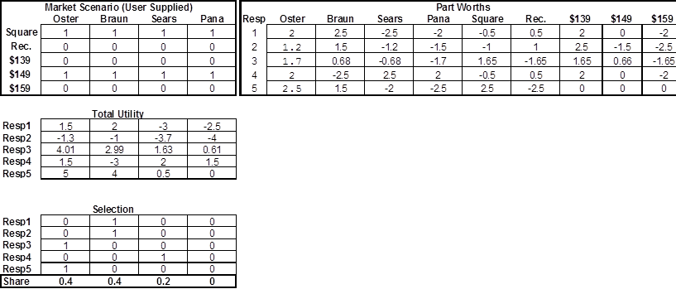
Reporting Conjoint Results: Conjoint Market Simulation and Simulators
From BreadMaker_SelfExplicted_Top.Line.Results.and.Share.Calculator.xls

